Slide 1

Gas Monitoring System
Team Members :
1.Shivam Mishra (201903029)
2.Mitesh Rege (201903038)
3.Prajna Shetty (201903046)
Grp No : 03
XIE TE IT
GUIDE :
Prof. Suvarna Aranjo

Slide 2
PROBLEM STATEMENT
A gas detector is to ease humans on detecting the presence of those dangerous gases within an area to prevent disaster.
Nowadays, the gas detector has been innovated into various ways of detection, for example infrared thermal imaging gas leak detection, gas leakage detection with monitoring system, and wireless gas sensor network.
This project has designed and developed a wireless gas monitoring system by using Arduino and ThingSpeak

Slide 3
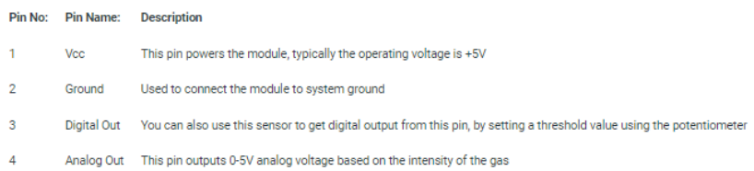
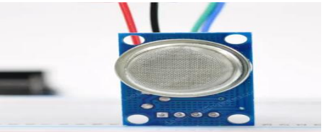
System Description
MQ2 Sensor :
MQ2 is one of the commonly used gas sensors in MQ sensor series

Slide 4
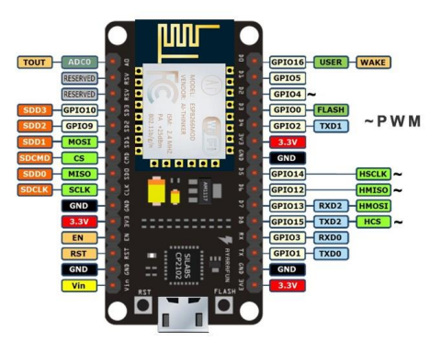
System Description Continue
NodeMCU ESP8266
NodeMCU WIFI Serial Wireless Module The development board equips the ESP-12E module containing ESP8266 chip having Tensilica Xtensa® 32-bit LX106 RISC microprocessor which operates at 80 to 160 MHz adjustable

Slide 5
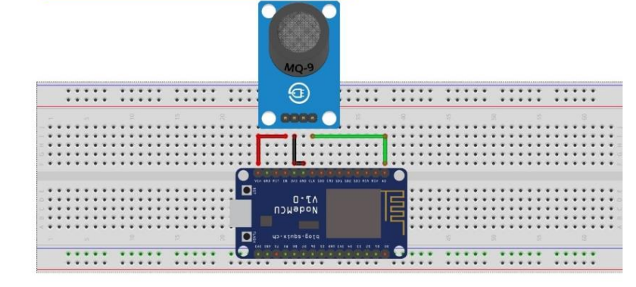
CIRCUIT DIAGRAM
Connect VCC pin of MQ-2 Gas Sensor module to Vin pin of NodeMCU ESP8266-12E Board.
Connect GND pin of MQ-2 Gas Sensor module to GND pin of NodeMCU pin of ESP8266-12E Board.
Connect D0 pin of MQ-2 Gas Sensor module to the A0 pin of NodeMCU ESP8266-12E board

Slide 6
Conclusion
Gas monitoring system is essential to prevent accidents and to save human lives. When you have a gas detection system, you can monitor the amount of gases in your environment. Because of this, you can tell when there is a higher chance of poisoning, explosion, fire or asphyxiation. From this we can clearly understand the importance of IOT in the coal and gas industries. It will make the continuous monitoring of gas level very easy.

Slide 7
THANK YOU !

